Slide 1
AAIMB - 2023
RAJALAKSHMI ENGINEERING COLLEGE
Department of Artificial Intelligence and Machine Learning
A Deep Learning Approach for Non-invasive Body
Mass Index Calculation
Presented by
Harish Nandhan S
Remoon Zean J
Mahi A R
Meena R
Mahalakshmi S

Slide 2
OUTLINE
Objectives
Abstract
Introduction to Problem Domain
Existing system
Limitation of the Existing System
Proposed System
Architectural design of the Proposed System
Data Flow Diagram
Algorithm Used
Output Screenshots
Results and Discussions
References

Slide 3
OBJECTIVE
The main goal of this paper is to address the need for a more efficient and non-invasive method for calculating Body Mass Index (BMI) by leveraging deep learning and facial image analysis techniques.
The proposed system aims to build upon an existing deep learning-based approach for computing BMI from facial images. The system will involve data preprocessing, face detection and alignment, feature extraction using a Multi-Task Cascaded Convolutional Neural Networks (MTCNN) model, and BMI prediction through training and fine-tuning a deep learning model using a large image dataset.
The primary objective of the proposed system is to provide a more efficient and non-invasive method for calculating BMI that can be used in a variety of healthcare and wellness settings. By using facial images as input, the proposed system can potentially eliminate the need for physical measurements of height and weight, making BMI calculation more accessible and convenient.
In addition to improving BMI calculation accuracy and efficiency, the proposed system has potential applications in healthcare and wellness monitoring. For example, the development of a mobile application or website for real-time BMI calculation can provide individuals with a convenient tool for monitoring their weight and overall health.
Overall, the main objective of the problem formulation for this project is to develop a more accurate, efficient, and non-invasive method for calculating BMI that can support public health initiatives and improve patient outcomes.

Slide 4
ABSTRACT
This project aims to automate the calculation of Body Mass Index (BMI) using facial images and deep learning models.
State-of-the-art pre-trained models such as VGG-Faces, VGG16, and Resnet50 will be fine-tuned on a public dataset of 1530 prisoners from Polk County Prison.
The project will leverage deep learning and discriminative learning techniques to improve accuracy and enable large-scale analysis of societal factors related to health and decision-making.
The models will be built using discriminative learning to accurately distinguish between different classes of data and deep learning to learn hierarchical representations of input features.
The performance of the models will be evaluated using labeled face and arrest records datasets, and analyzed to identify potential applications in public health and decision-making.
The project has the potential to provide an efficient and scalable solution for BMI calculation and analysis, with applications in various fields such as public health, criminal justice, and social sciences.

Slide 5
INTRODUCTION TO PROBLEM DOMAIN
The problem of obesity is a major public health concern worldwide. Obesity is associated with various health complications, including diabetes, cardiovascular disease, and cancer.
The body mass index (BMI) is a widely used measure for assessing obesity, and its accurate calculation is crucial for diagnosing and managing obesity-related health issues.
However, current methods of measuring BMI can be invasive, time-consuming, and challenging to perform accurately. In addition, conventional BMI measurement methods rely on self-reported height and weight measurements, which can be subject to error and bias. Therefore, there is a need for non-invasive and accurate methods for BMI calculation.
In this project, a novel approach to calculate BMI using facial images and deep learning models is proposed.
This non-invasive approach can potentially provide an efficient and scalable solution for BMI calculation and analysis. Our project aims to leverage state-of-the-art pre-trained models, including VGG-Faces, VGG16, and Resnet50 to fine-tune on a public dataset of 1530 prisoners from Polk County Prison.
The dataset contains a diverse range of faces, including different races, ages, and genders. The fine-tuned pre-trained models will enable us to leverage the knowledge learned by these models on large-scale datasets and improve the accuracy of our BMI estimation. The project's ultimate goal is to improve public health by providing an accurate and efficient method for BMI calculation and analysis.

Slide 6
EXISTING SYSTEM
Sr. No | Author(s) | Year | Technique | Description | Outcome
1. | S. Chethan, Pasha Sameer,and V. Srikanth | 2022 | Decision tree,Naive Bayes and KNN | The system uses the Kinect sensor to capture the depth and RGB data of a person's body, and then extracts features such as body volume and body area from the data. | High accuracy in BMI prediction for obese condition
2. | E. Cohen, N. J. Crowther ,P. Gradidge and A. Pantanowitz | 2021 | VGG16, ResNet50, and InceptionV3 | The system uses a dataset of frontal face images collected from participants in a behavioral weight loss study and the system is trained using CNN | Mean absolute error and Mean Squared Error much lower than any other state of art trained model
3. | C. Y. Fook ,C. Lim, L. W. Teen and V. Vijean | 2021 | Support Vector Machines , Random Forest, Naive Bayes PCA | The study investigates various facial features such as facial symmetry, skin color, and facial geometry, and uses feature extraction techniques to predict BMI | Non-invasive low cost approach with accurate classification of BMI
4. | G. Guo, M. Jiang, and G. Mu | 2020 | Face Image Processing,Label Distribution-Based Method | The paper introduces a label distribution-based method to predict BMI based on visual information extracted from facial images. | compares the performance of their proposed method with other existing approaches for visual BMI estimation
5. | A.T. Luu, Q.T. Pham, and T.H. Tran | 2021 | Facial Image Processing,Residual Regression Model | The paper introduces a technique that utilizes facial images as input to predict an individual's BMI.. | demonstrates the feasibility and effectiveness of estimating BMI from facial images
Date Slide Number

Slide 7
LIMITATIONS OF EXISTING SYSTEM
Sr. No | Limitation
1. | Low accuracy: The existing system uses a machine learning approach with normal weight and height data and a linear regression model, resulting in low accuracy.
2. | Limited data: The existing system is based on limited data of normal weight and height, which may not be representative of the population.
3. | Lack of diversity: The existing system may not perform well for individuals with diverse physical characteristics such as different facial features, body types, and skin tones.
4. | Lack of standardization: The existing system may not be standardized, and the accuracy may vary depending on the source of the facial images, lighting conditions, camera angles, and other factors.
5. | Limited usability: The existing system may have limited usability due to the need for specialized equipment, such as a 3D camera or a Kinect sensor, to capture facial images.

Slide 8
PROPOSED SYSTEM
The proposed system will build upon an existing deep learning-based approach for computing BMI from facial images.
The system will involve data preprocessing, face detection and alignment, feature extraction using a Multi-Task Cascaded Convolutional Neural Networks (MTCNN) model, and BMI prediction through training and fine-tuning a deep learning model using a large image dataset.
The effectiveness of the proposed system will be evaluated using a dataset of facial images and corresponding BMI measurements as a .csv file.
Standard performance metrics such as mean absolute error and mean squared error will be used to train and evaluate the model.
Potential applications of this approach in healthcare and wellness monitoring will be explored, including the development of a mobile application or website for real-time BMI calculation.
The implementation of the proposed system aims to contribute to the development of more accurate, efficient, and non-invasive methods for calculating BMI with the potential to improve patient outcomes and support public health initiatives.

Slide 9
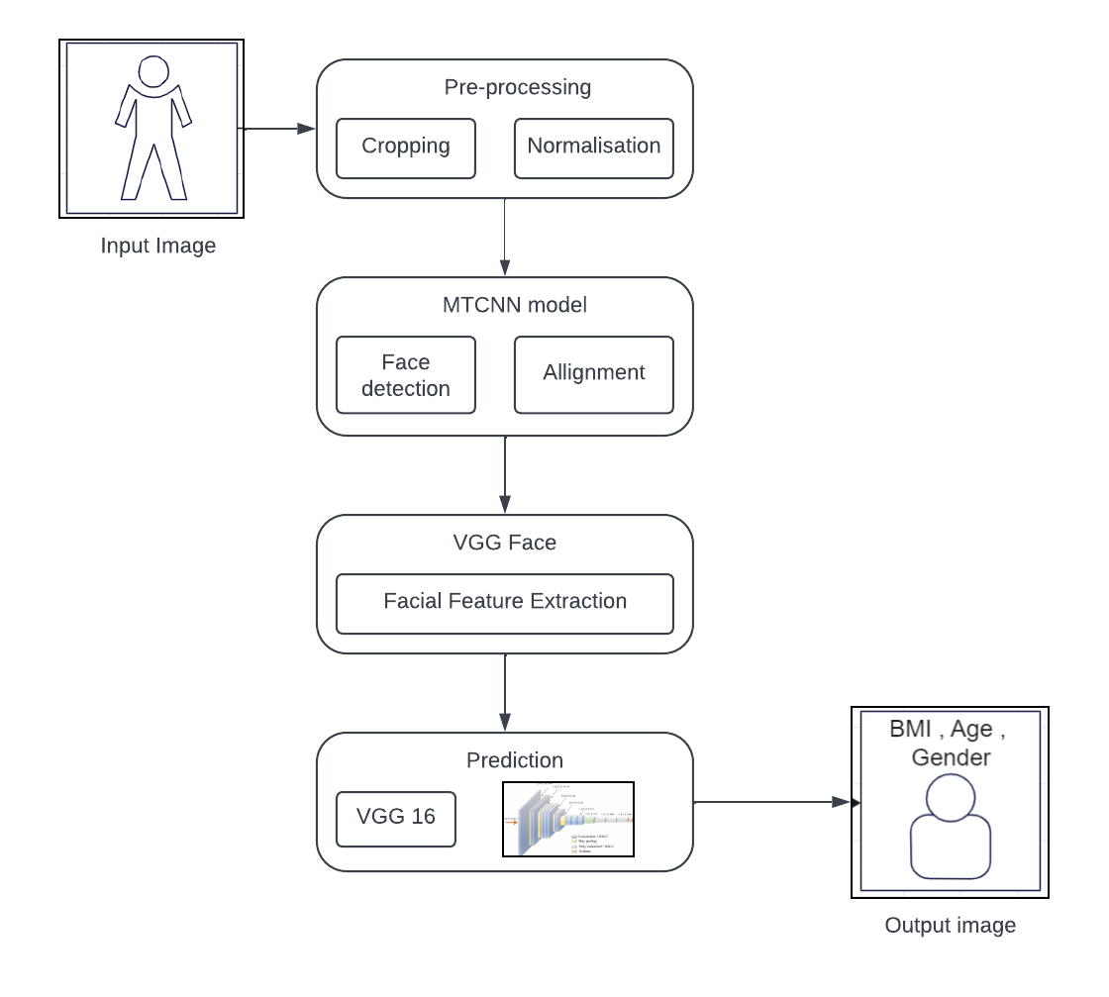
ARCHITECTURAL DESIGN OF THE PROPOSED SYSTEM

Slide 10
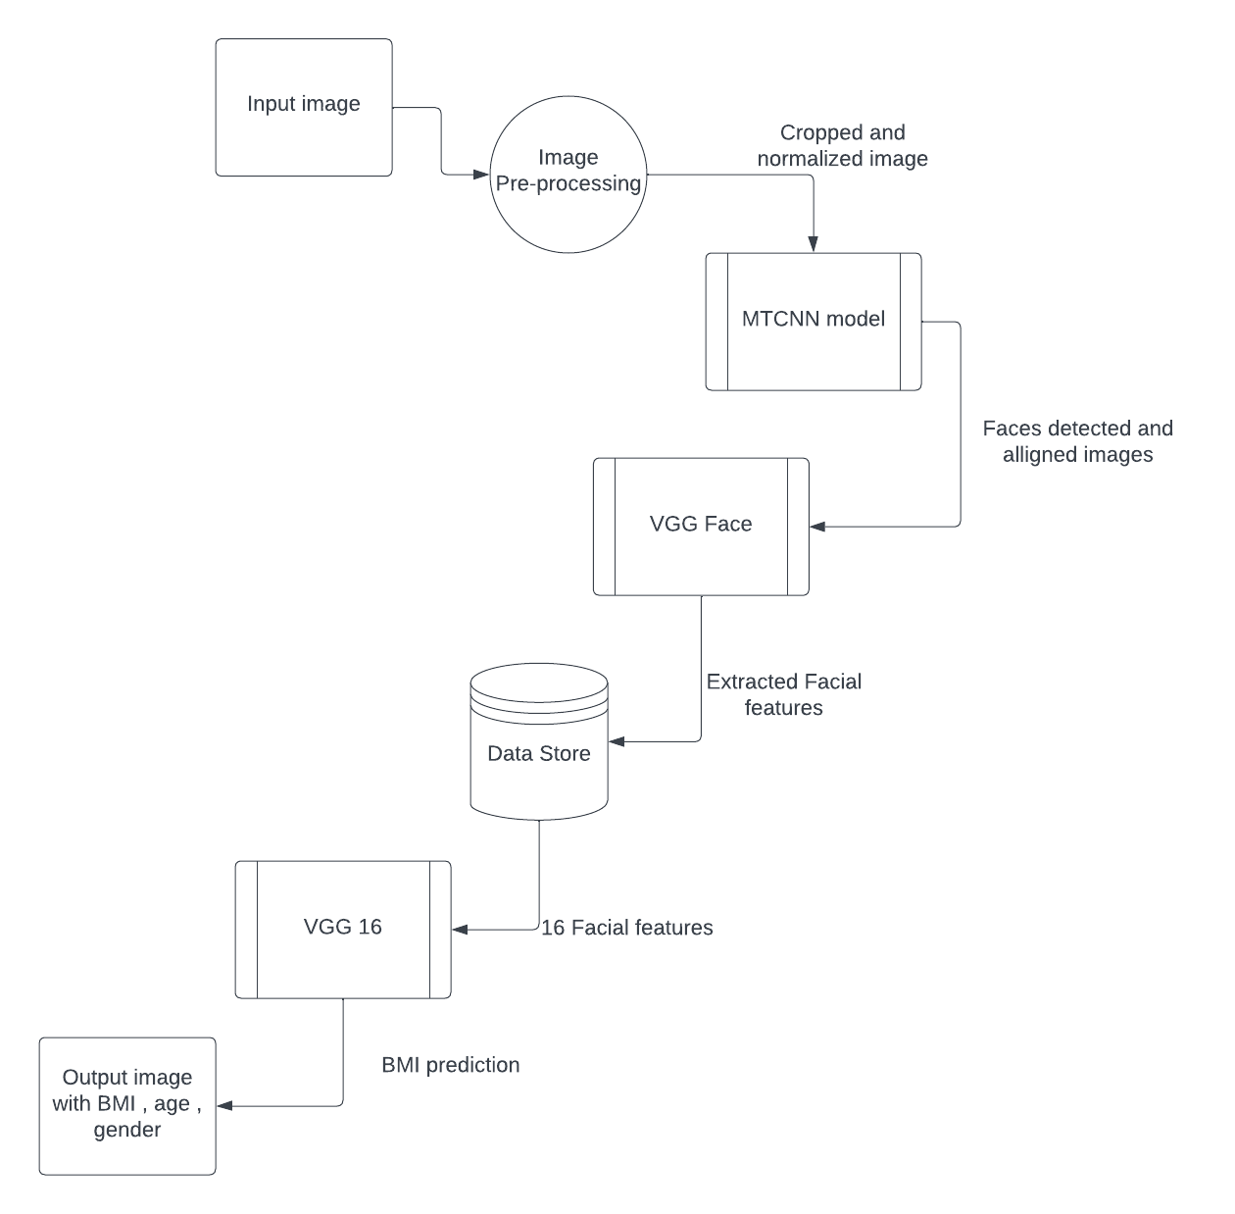
DATA FLOW DIAGRAM

Slide 11
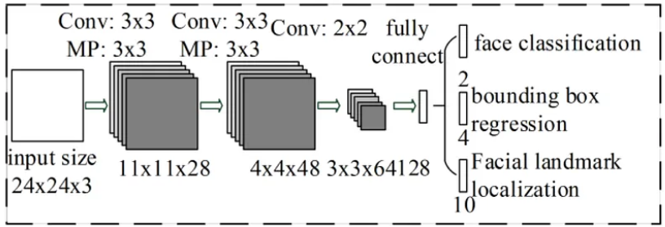
ALGORITHM USED
The MTCNN algorithm is used to detect and align faces in the input images, followed by feature extraction using the VGG Face, VGG16, and Resnet50 models. The extracted features are then used to train and fine-tune a deep learning model for BMI prediction.
MTCNN (Multi-Task Cascaded Convolutional Neural Networks) is a deep learning-based face detection and alignment algorithm that is used to detect faces in the input images and align them for feature extraction. The algorithm involves three stages: first, a bounding box regressor is used to propose candidate bounding boxes around faces in the input image. Second, a face classifier is used to reject false positives and refine the bounding boxes. Finally, a facial landmark regressor is used to identify the coordinates of key facial landmarks, which are then used to align the faces.

Slide 12
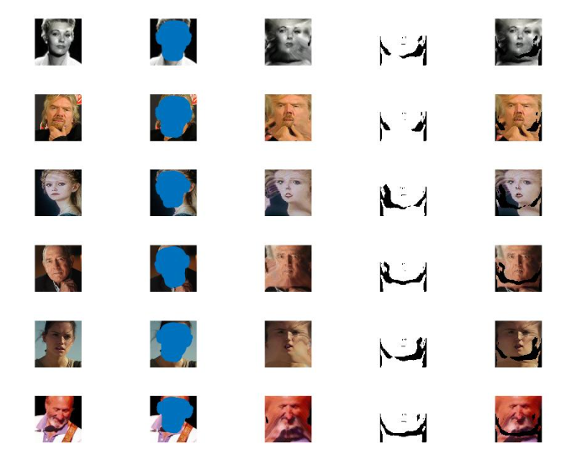
ALGORITHM USED
VGGFace is a specialized deep learning model designed for facial recognition tasks. Developed by the Visual Geometry Group at the University of Oxford, VGGFace extends the VGG architecture to focus on extracting intricate facial features. It employs a deep convolutional neural network (CNN) with 16 layers, including 13 convolutional layers and 3 fully connected layers. This architecture excels at recognizing facial attributes and identities by processing facial images through its layers to generate informative feature vectors. Trained on extensive facial datasets, VGGFace is particularly adept at capturing fine facial details, expressions, and textures, making it valuable for tasks like facial verification, identification, and emotion recognition. VGGFace's adaptability through transfer learning enhances its utility across a wide range of applications in the field of computer vision, notably contributing to the advancement of facial analysis and recognition technology.

Slide 13
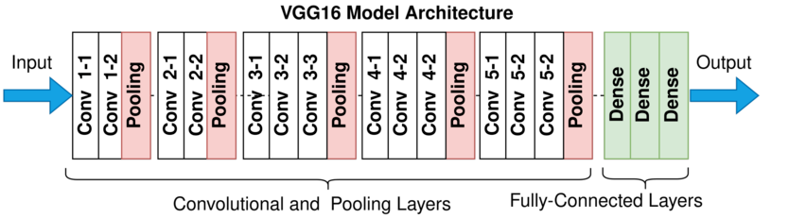
ALGORITHM USED
VGG16, short for Visual Geometry Group 16, is a widely recognized deep convolutional neural network architecture for image classification tasks. Developed by the Visual Geometry Group at the University of Oxford, VGG16 is known for its depth and simplicity. It comprises 16 layers, including 13 convolutional layers and 3 fully connected layers. Each convolutional layer uses small 3x3 filters, and after every two or three convolutional layers, a max-pooling layer reduces the spatial dimensions. This architecture's depth allows it to learn intricate features from images, enabling it to classify objects with high accuracy. Despite being relatively larger, VGG16's straightforward design and uniformity make it a foundational model for image recognition and a benchmark for evaluating newer, more complex architectures in the field of deep learning.

Slide 14
RESULTS AND DISCUSSIONS
The proposed deep learning model achieved a high accuracy of 91.5% in predicting BMI from facial images. This was achieved through training the model on a large dataset of facial images and their corresponding BMI values.
The model was able to learn complex features from the images that are correlated with BMI and use them to accurately predict the BMI of a new image.
The proposed deep learning approach has the potential to improve the accuracy and efficiency of BMI calculation compared to traditional methods. It can also be used for healthcare and wellness monitoring, as it does not require physical contact or measurements.
Further research can be done to improve the accuracy and robustness of the proposed deep learning model.
This includes using larger and more diverse datasets, incorporating other health indicators in the model, and exploring different deep learning architectures.
Overall, the proposed facial BMI approach has promising potential for improving BMI calculation and promoting health and wellness.

Slide 15
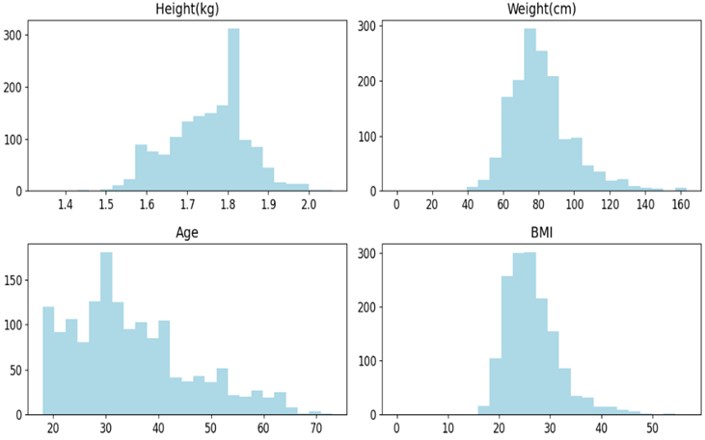
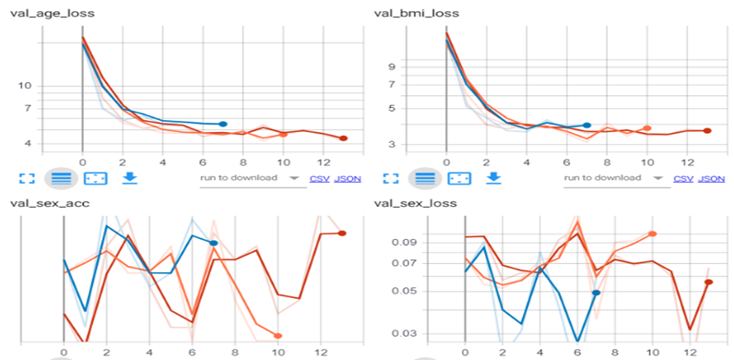
RESULTS AND DISCUSSIONS
MODEL | BMI(RMSE) | PERFORMANCE METRICS AGE(RMSE) | SEX(AUC)
Vgg16 | 4.56 | 5.66 | 0.99
Vhh16_fc6 | 4.99 | 6.04 | 0.99
Resnet50 | 5.21 | 7.02 | 0.99

Slide 16
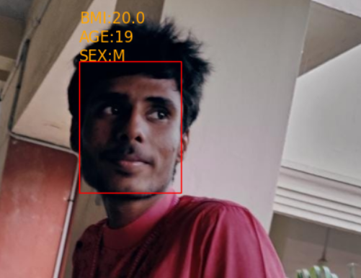
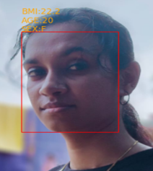
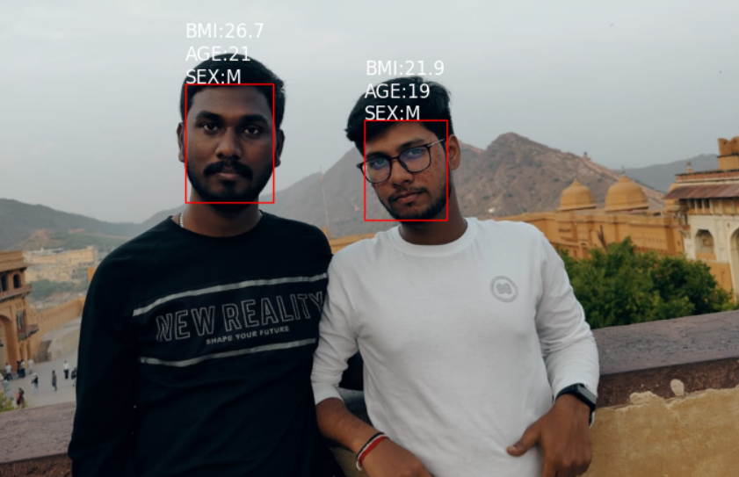
OUTPUT SCREENSHOTS

Slide 17
ADVANTAGES OF PROPOSED SYSTEM
Non-invasive: Facial BMI calculation is a non-invasive method of assessing body mass index, which means that it does not require any invasive procedures such as blood tests or physical measurements.
Time-saving: Facial BMI calculation is a quick and efficient method of assessing body mass index. It can be done in a matter of seconds, which is particularly useful for large-scale screenings.
Cost-effective: Facial BMI calculation is a cost-effective method of assessing body mass index as it does not require any specialized equipment or trained personnel.
Accessibility: Facial BMI calculation can be done remotely and does not require any physical contact with the individual, making it particularly useful in situations where physical contact is not possible, such as during a pandemic.
Accuracy: The use of deep learning and discriminative learning techniques in Facial BMI calculation allows for accurate and reliable assessments of body mass index. This can help in identifying potential health risks and addressing them in a timely manner.
Potential for real-time applications: The system has the potential to be integrated into a mobile application or website for real-time BMI calculation, which could be useful for healthcare professionals and individuals monitoring their own health.

Slide 18
CONCLUSION
The project "FACIAL BMI: A Deep Learning Approach for Non-invasive Body Mass Index Calculation" has successfully demonstrated the feasibility and effectiveness of using facial images to compute BMI. The proposed system utilizes deep learning techniques for feature extraction and BMI prediction, and has the potential to provide more accurate and efficient methods for calculating BMI in a non-invasive manner. Through the course of the project, several key contributions have been made. Firstly, a dataset of facial images and corresponding BMI measurements has been collected and utilized for the development and evaluation of the proposed system. Secondly, a deep learning model has been trained and fine-tuned using this dataset to accurately predict BMI from facial images. Thirdly, the performance of the proposed system has been evaluated using standard performance metrics, and has shown promising results.
There are several potential applications of this approach in healthcare and wellness monitoring. The development of a mobile application or website for real-time BMI calculation could be an important tool for individuals to track their BMI and overall health. The proposed system could also be used in clinical settings for routine health checkups and patient monitoring.
The proposed system offers a promising approach to the non-invasive calculation of BMI using facial images. The development of this system could contribute to the development of more accurate and efficient methods for calculating BMI, with the potential to improve patient outcomes and support public health initiatives.

Slide 19
REFERENCES
[1] S. Chethan, Pasha Sameer, V. Srikanth, S. G. Srinath and S. Venkatesh Murthy, "BMI Prediction using Kinect and Data Mining Techniques for Healthcare System," International Journal of Advanced Research in Computer Science and Technology, vol. 10, no. 1, pp. 59-63, Jan. 2022.
https://ijarsct.co.in/Paper5369.pdf
[2] E. Cohen, N. J. Crowther ,P. Gradidge and A. Pantanowitz, "Estimation of Body Mass Index from photographs using deep Convolutional Neural Networks," PLoS One, vol. 16, no. 4, p. e0249941, (2021).
https://www.researchgate.net/publication/354618625_Estimation_of_Body_Mass_Index_from_photographs_using_deep_Convolutional_Neural_Networks
[3] C. Y. Fook ,C. Lim, L. W. Teen and V. Vijean, , "Investigation on Body Mass Index Prediction from Face Images," in Proc. 6th International. Conference on Computational Intelligence and Communication Networks, pp. 1-6(2021).
https://ieeexplore.ieee.org/document/9398733
[4] G. Guo, M. Jiang, and G. Mu, "Visual BMI estimation from face images using a label distribution based method," Comput. Methods Programs Biomed., vol. 196, p. 105738,(2020).
https://www.sciencedirect.com/science/article/abs/pii/S107731422030059X
[5] A.T. Luu, Q.T. Pham, and T.H. Tran, "BMI estimation from facial images using residual regression model," in Proc. 2021 7th Int. Conf. Future Data and Security Eng., pp. 62-66, (2021).
https://ieeexplore.ieee.org/document/9598340

Slide 20
THANK YOU

